Slide 2

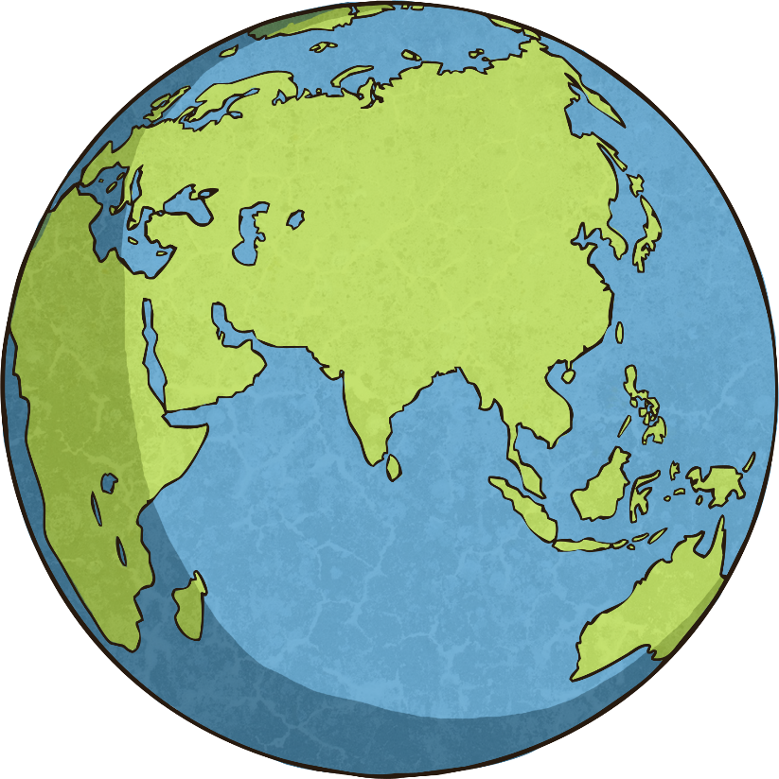
The Blue Planet
Earth is referred to as ‘The Blue Planet’ because it looks blue from afar.

Slide 3
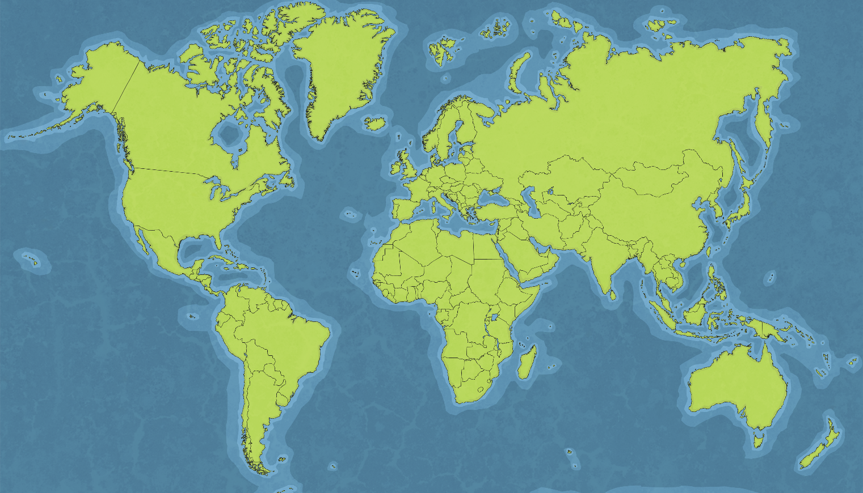
The Oceans
The Earth looks blue because 70% of its surface is covered by water. There are five oceans that cover the world. Can you name them?
Arctic Ocean
Pacific Ocean
Atlantic Ocean
Indian Ocean
Pacific Ocean
Southern Ocean

Slide 4
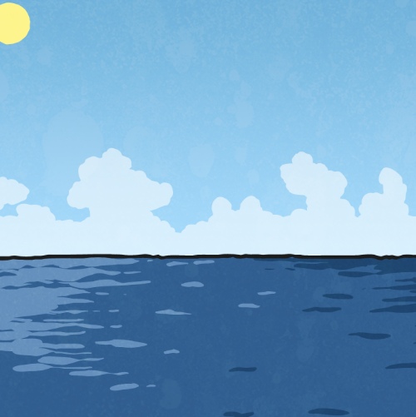

Sunlight
Sunlight shines on the oceans just like on the land. However, light does not reach the deepest layers of the ocean.

Slide 5
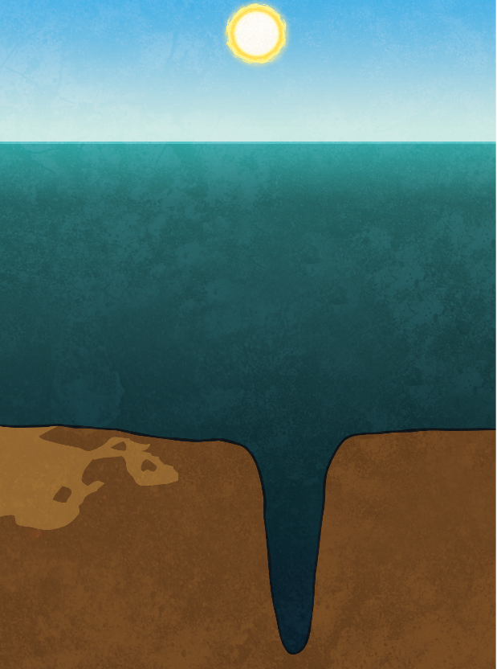
The Layers
The depth of the oceans are split into layers. Each layer has its own specific characteristics.
The Sunlight Zone (0m-200m)
The Twilight Zone (200m-1000m)
The Midnight Zone (1000m-4000m)
The Lower Midnight Zone (4000m-6000m)
The Trenches (Lower than 6000m)

Slide 6


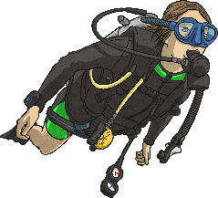
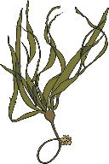
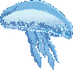
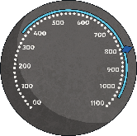
0-200m The Sunlight Zone
The sunlight zone (the Epipelagic zone) is where most ocean organisms live because it receives the most sunlight.
Temperature 12-20°C
A scuba diver can reach a depth of 40m-50m.
Plants such as seaweed, phytoplankton and flowering plants can live here as they can get sunlight to perform photosynthesis.
Most types of fish and animals, including dolphins, turtles, rays, seals, coral and jellyfish, live in this zone.
The pressure here is 1 atmosphere, which is the same as a 1kg weight on your fingernail.

Slide 7
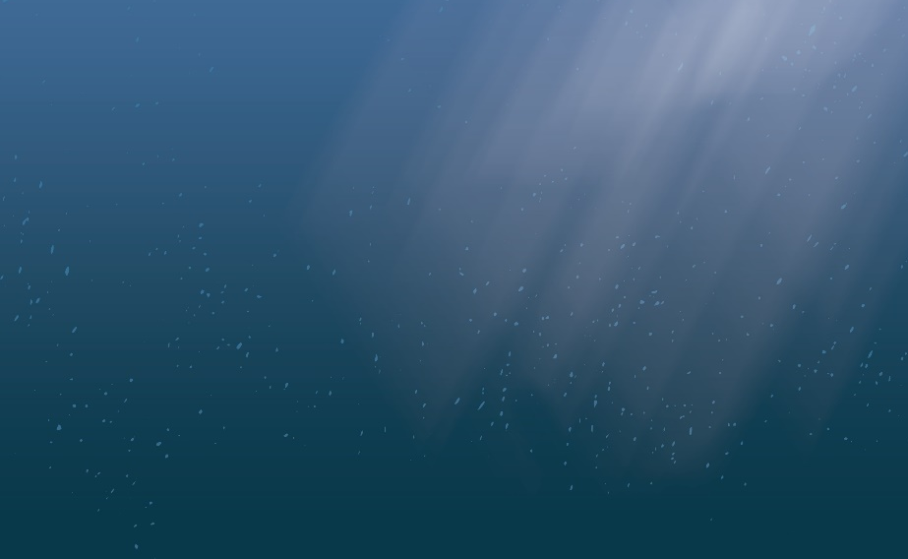
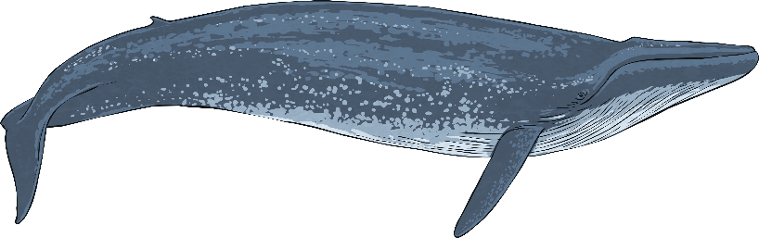
The Twilight Zone (200m-100m)
This layer is also known as the mesopelagic zone (Greek for ‘middle’). Very little sunlight reaches this zone.
Temperature 4-13°C
Animals such as whales, shrimps, swordfish, hatchet fish and octopuses live in this zone.
No plants grow in this zone because there is not enough sunlight to perform photosynthesis.
You will also find sponges living at these depths. People often think that they are plants but they are actually sessile (non-moving) animals.
The pressure here is 29-88 atmospheres which is the same as a 29kg-88kg weight on your fingernail.

Slide 8

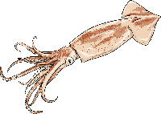

The Midnight Zone (1000m-4000m)
This layer is also known as the bathypelagic zone (Greek for ‘deep’). Sunlight does not reach this layer.
Temperature 4°C
2438m is the operating depth of an oil rig. The Titanic was found at a depth of 3800m.
In this zone, you will find animals such larger whales, squid, echinoids and blob fish.
The only light in this zone is produced by bioluminescent (light-producing) animals, such as the angler fish.
The pressure here is 100-393 atmospheres which is the same as a 100kg-393kg weight on your fingernail.

Slide 9
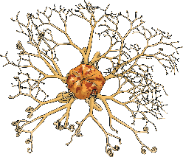
The Lower Midnight Zone (4000m-6000m)
Temperature 0°C
This layer is also known as the abyssopelagic zone (Greek for ‘very deep or bottomless’). Conditions in this zone are extremely dark and the temperatures are very cold.
This zone is the largest environment on Earth.
The deepest point of the Arctic Ocean is 5450m below sea level.
The pressure here is 400-590 atmospheres which is the same as a 400kg - 590kg weight on your fingernail.
The organisms that live in this zone include sea spiders, basket stars, medusas and sea pigs.

Slide 10

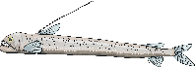
The Trenches (Lower than 6000m)
This layer is also known as the hadopelagic zone (named after the Greek underworld, Hades). It is pitch black and temperatures are very cold.
Temperature 0°C
Challenger Deep in the Mariana Trench is the deepest place on Earth. It was first explored by Jacques Picard and Don Walsh.
Most animals living in this zone are unable to see.
Some fish live in this zone, such as rat-tail fish and liparid fish. Amphipods wait for scarce food to drop down. Decapods, which eat amphipods, also live in this layer.
The pressure here is 600-1000 atmospheres which is the same as a 600kg-1000kg weight on your fingernail.

Slide 11
The Bottom: The Mariana Trench
The Mariana Trench is the deepest place on Earth. It is 11,000m deep.
You can find out more about it and its inhabitants here in this short documentary..

